Slide 1
Project 2 – simulated annealing traveling salesman (SATS)
Austin Phillips, Angel Rodriguez

Slide 2
The Traveling Salesman Problem
This problem contains a discrete domain since all the coordinates are known and given. The traveling salesman problem is an optimization problem in which the minimum length path through a circuit is found. Here are N cities with positions(x, y).
The problem is to find a path which visits each city exactly once and returns to the original city. Since there are N cities, there are N! different orders in which they may be visited. With 20 points given for this problem, there are 2.4329020118x10^18 different possible paths which makes it impractical to choose a random path of travel.

Slide 3
SIMULATED ANNEALING
Simulated annealing is a Monte Carlo method that can be used to seek the optimum of a multi-modal function. The name of the algorithm comes from annealing in metallurgy, a technique involving heating and controlled cooling of a material to alter its physical properties. Both are attributes of the material that depend on their thermodynamic free energy. Heating and cooling the material affects both the temperature and the thermodynamic free energy or Gibbs energy.
Simulated annealing can be used for very hard computational optimization problems where exact algorithms fail; even though it usually achieves an approximate solution to the global minimum, it could be enough for many practical problems
This notion of slow cooling implemented in the simulated annealing algorithm is interpreted as a slow decrease in the probability of accepting worse solutions as the solution space is explored. Accepting worse solutions allows for a more extensive search for the global optimal solution instead of converging to a local minima. In general, simulated annealing algorithms work as follows:
The temperature progressively decreases from an initial positive value to zero (or small decimal value approaching 0). At each time step, the algorithm randomly selects a solution close to the current one, measures its quality, and moves to it according to the temperature-dependent probabilities of selecting better or worse solutions, which during the search respectively remain at 1 (or positive) and decrease toward zero.

Slide 4
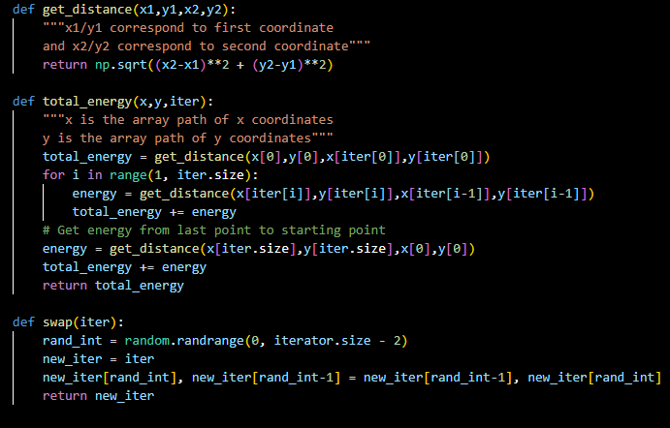
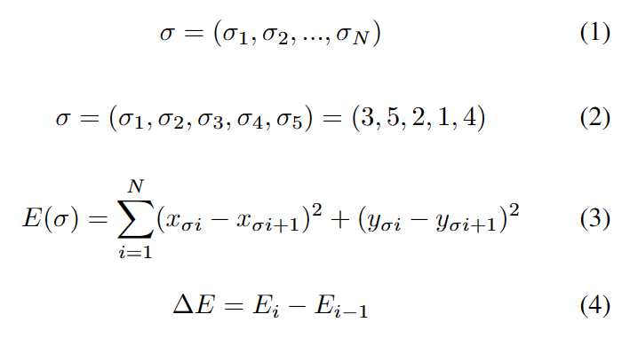
Calculating Energy and Swapping Elements in Iterator

Slide 5

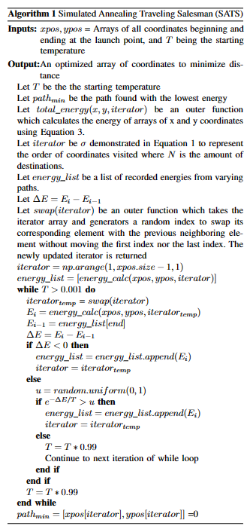
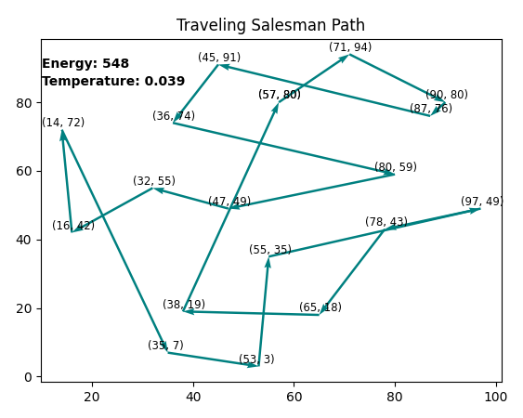
Simulated Annealing Algorithm in Python
Algorithm details with figure of plot displayed during program runtime

Slide 6
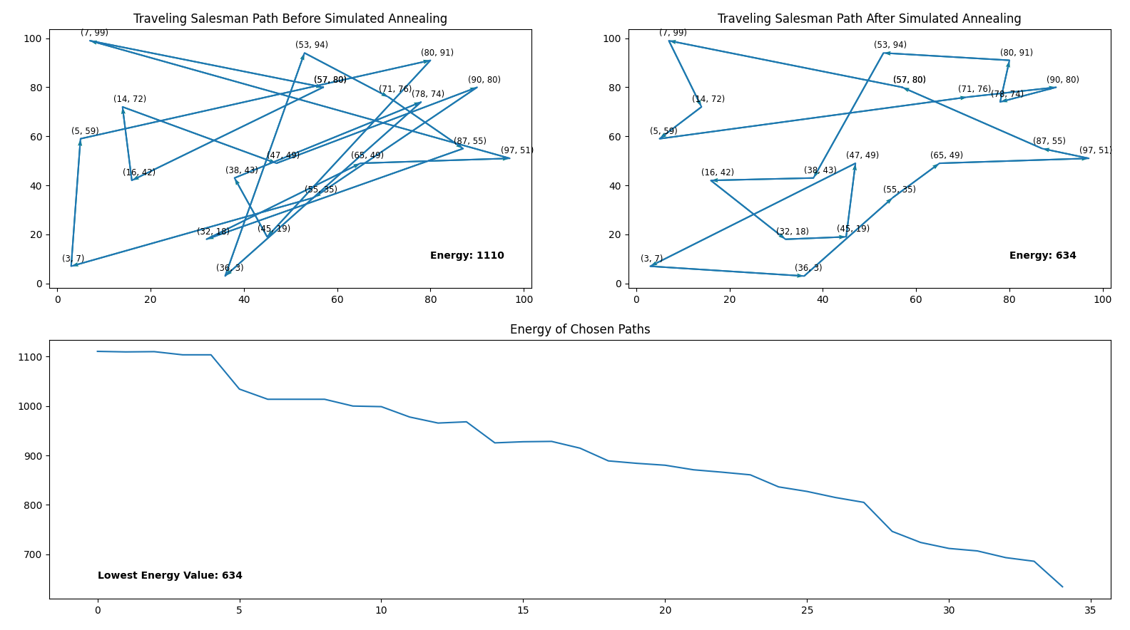
Results Showing Before and After Simulated Annealing with
Energy is 1110 using the coordinates in the order they were given and returning to the first coordinate of the list
Results of energy tend to lie in the 600s.
Energy can be observed converging to a much lower point with some instances of the energy chosen increasing from the previous path chosen.

Slide 7
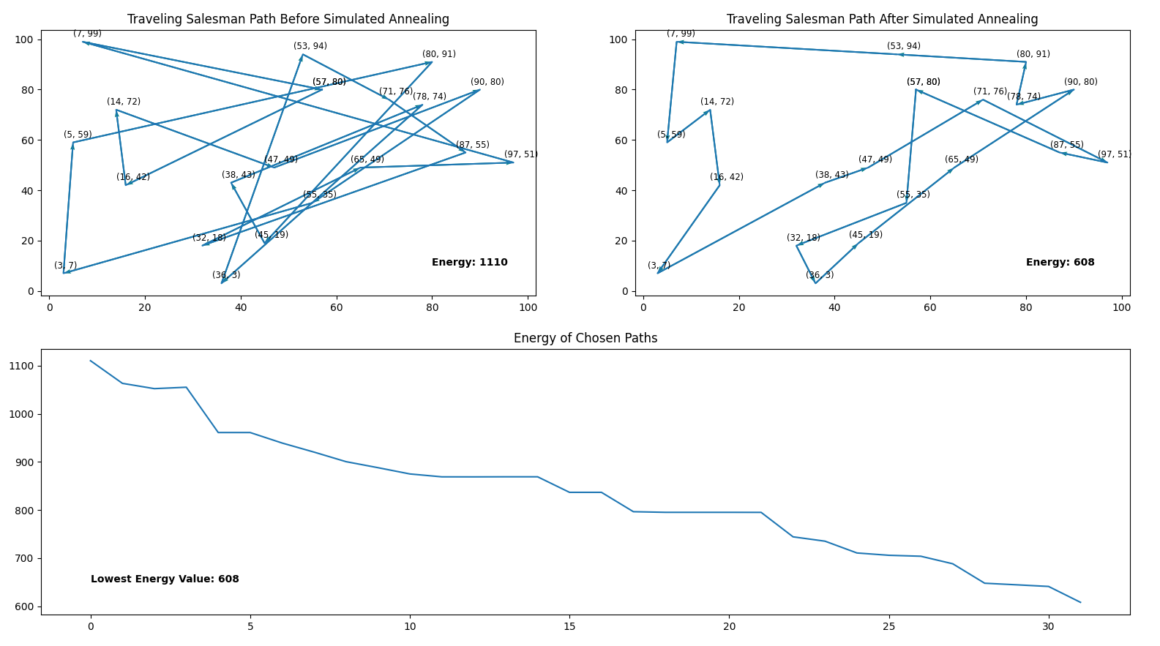
Lowest Energy Result
We obtained results using:
starting value T = 10
T decimation of T = T*0.99999
Running while T > 0.000001
Our best result has energy of 608 which is approximately 55% of original path energy.
Most runs end with a different energy value

Slide 8

Bugs Difficult to Solve
An objective included plotting the path of the most optimal path which involves keeping track of the iterator associated with the least calculated energy.
It was realized that Python does not make copies of arrays with the assignment operator =, but rather creates a pointer to the original array. This is fine until changes are made to the original array which pointed to by the copy and so changes are made to the copy as well. Since the iterator was constantly being updated, so was the optimal iterator leading to the optimal iterator holding an order of elements that did not result in the smallest energy value within energy_list.
The solution was that instead of coding optimal_iterator = iterator, optimal_iterator = copy.deepcopy(iterator) had to be used instead which created a true copy and not a pointer.

